Slide 1

Customer Personality Analysis and Segmentation

Slide 2
Project Objective
Goal: Analyse customer behaviour and spending patterns.
Action: Segment customers into distinct groups (clusters).
Outcome:
1. Enable targeted marketing campaigns.
2. Improve customer satisfaction.
3. Optimize product offerings.

Slide 3
Understanding the Dataset
Dataset Overview:
Contains customer demographics, purchasing habits, and engagement metrics.
Key Attributes:
1. Demographics: Age, marital status, income.
2. Behaviour: Spending on wine, meat, fruits, etc., over two years.
3. Engagement: Last purchase date, campaign responses, and complaints.

Slide 4
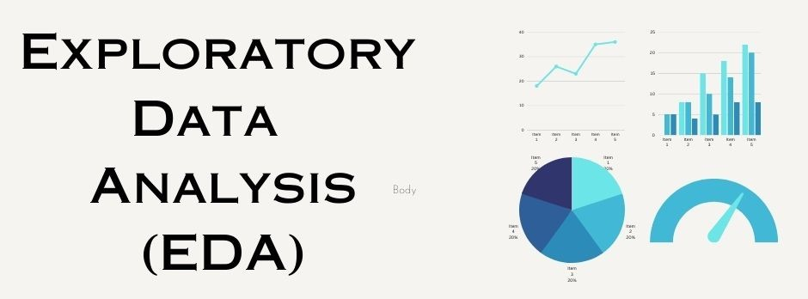

Slide 5
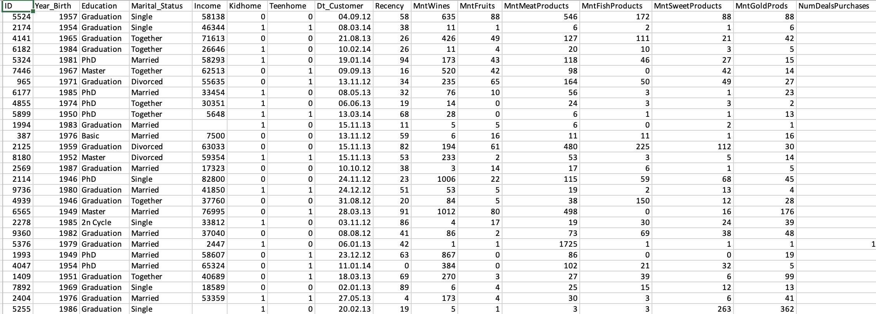
Dataset Overview

Slide 6
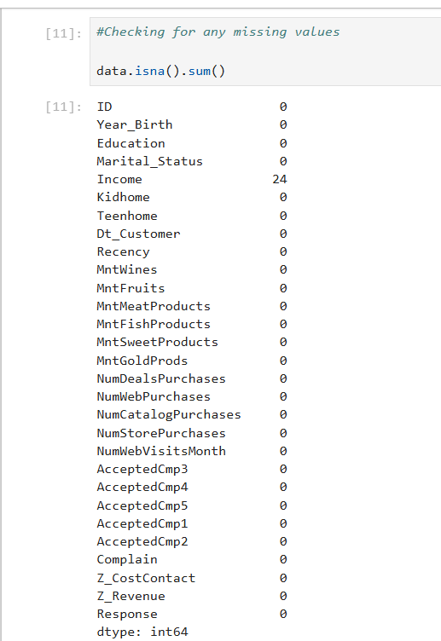
There are missing values in the Income column. We can either drop them or impute them.
Checking For Missing Values

Slide 7
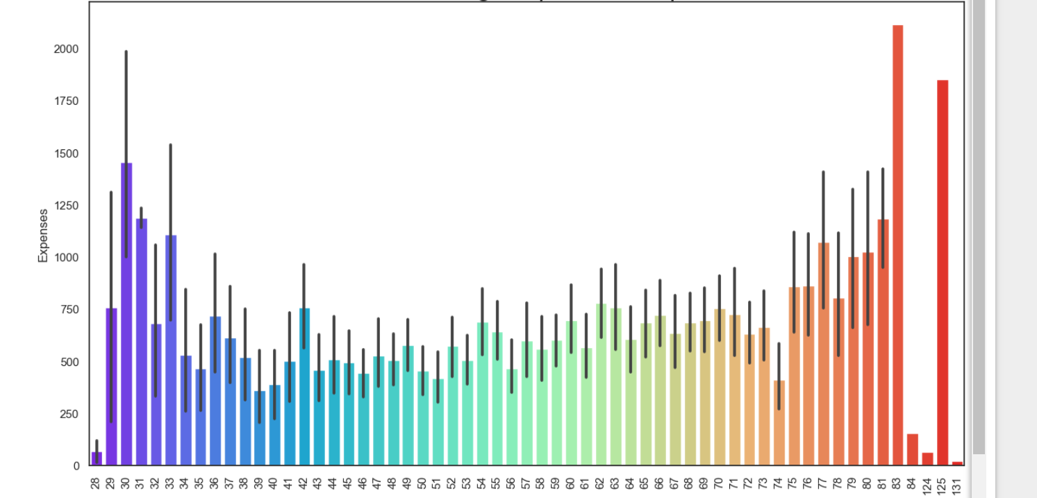
EDA – Insights of Expenses vs Customer Age People whoe are in middle age they have less expense than others

Slide 8
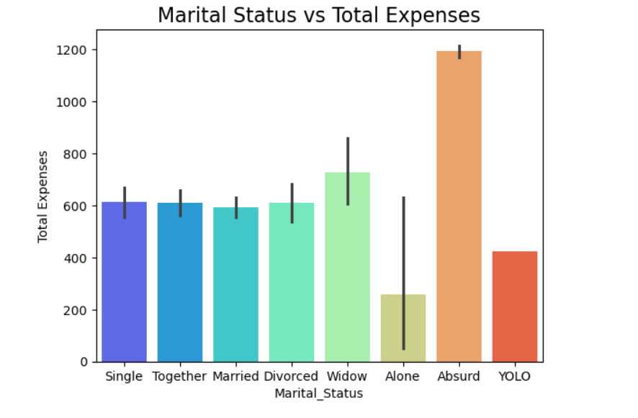
EDA – Insights of Marital Status

Slide 9
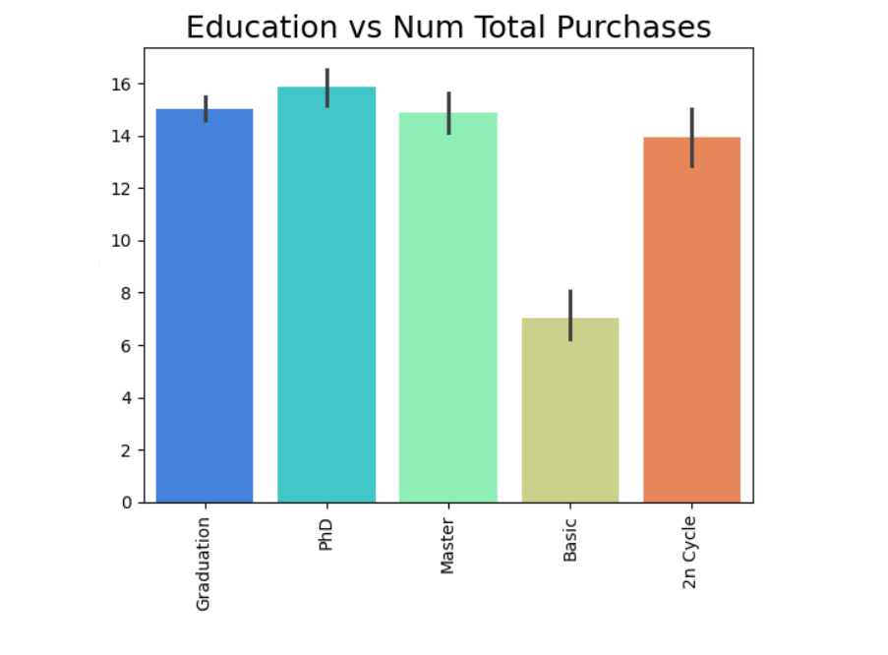
EDA- Insights of Education

Slide 10
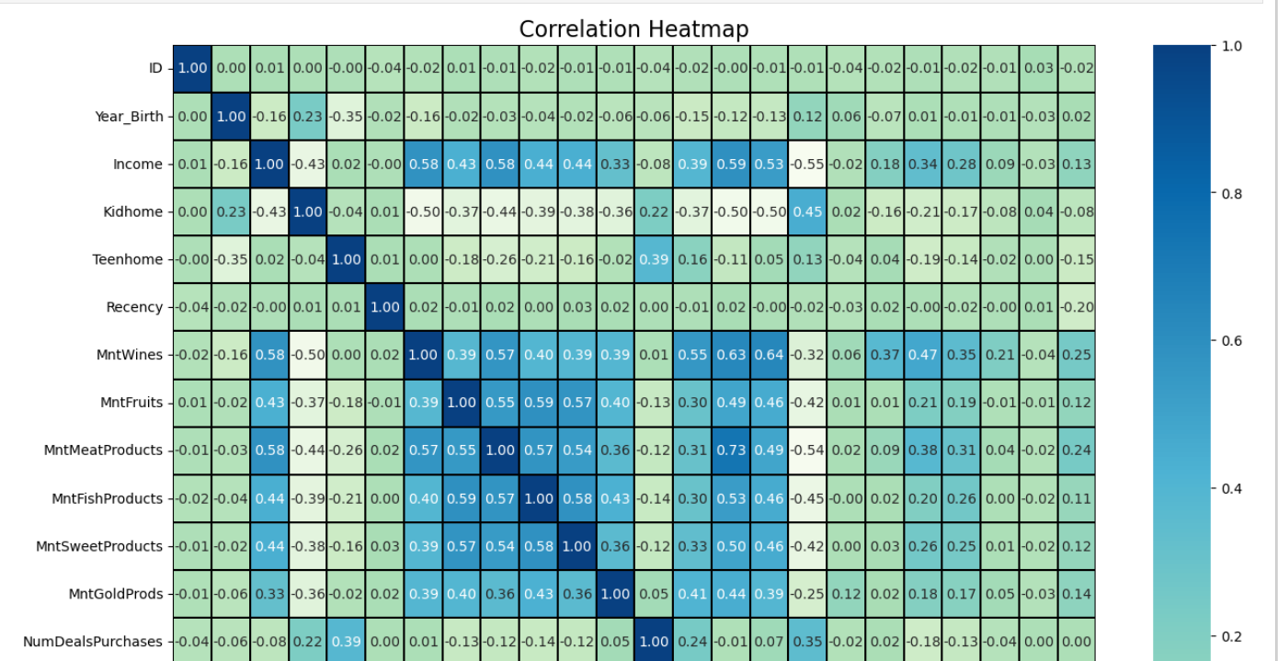
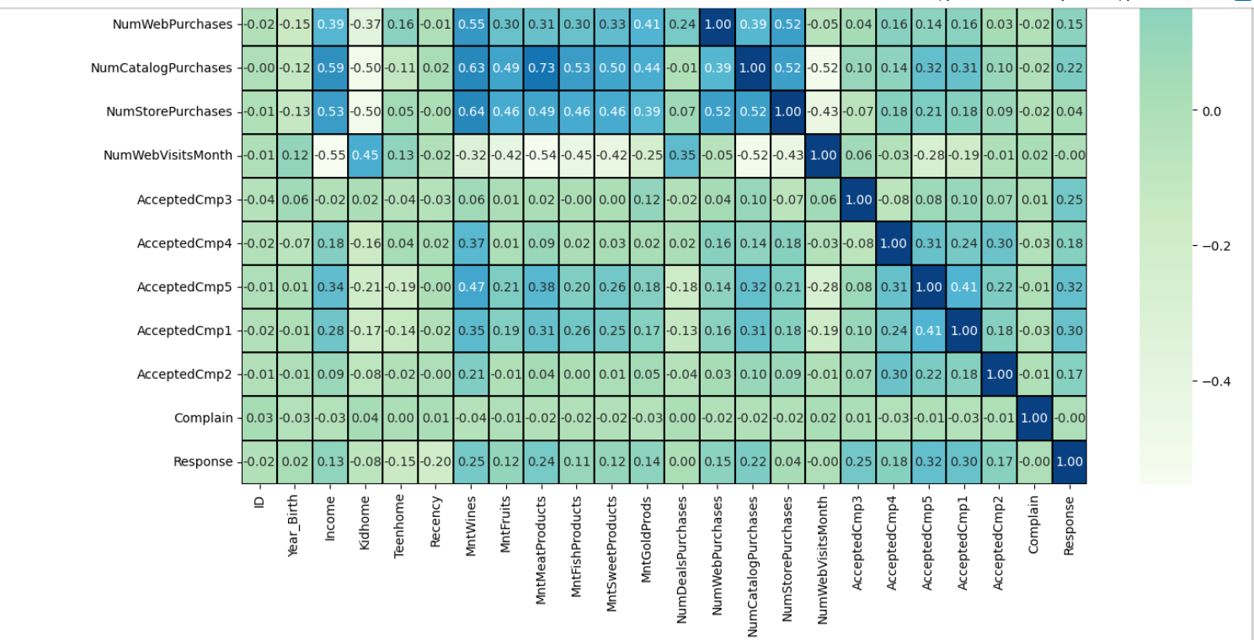
EDA - Insights from Heatmap

Slide 11
As From the above correlation heatmap we can draw few insights regarding the association between different attributes. Some of them are: The columns 'NumCatalogPurchases' and 'MntMeatProducts' have a strong correlation indicating that most of the amount that is spent on Meat products are made through catalog purchases. Also the columns 'MntWines' ,'NumStorePurchases' and 'NumCatalogPurchases' , 'MntWines' have a positive correlation indicating that the amount of money spent on Wines are made mostly either by visiting the store or through catalog. The column 'Income' has a postive association with the following attributes: 'MntWines','MntMeatProducts', NumCatalogPurchases','NumberStorePurchases' and 'NumWebVisitsMonth' which shows that higher the income, more chances of these attribuets to occur.

Slide 12
Model Building

Slide 13

Clustering - Methods and Goals
Clustering Purpose: Groups customers based on behaviour and traits.
Algorithms Used:
KMeans: Creates a fixed number of clusters.

Slide 14
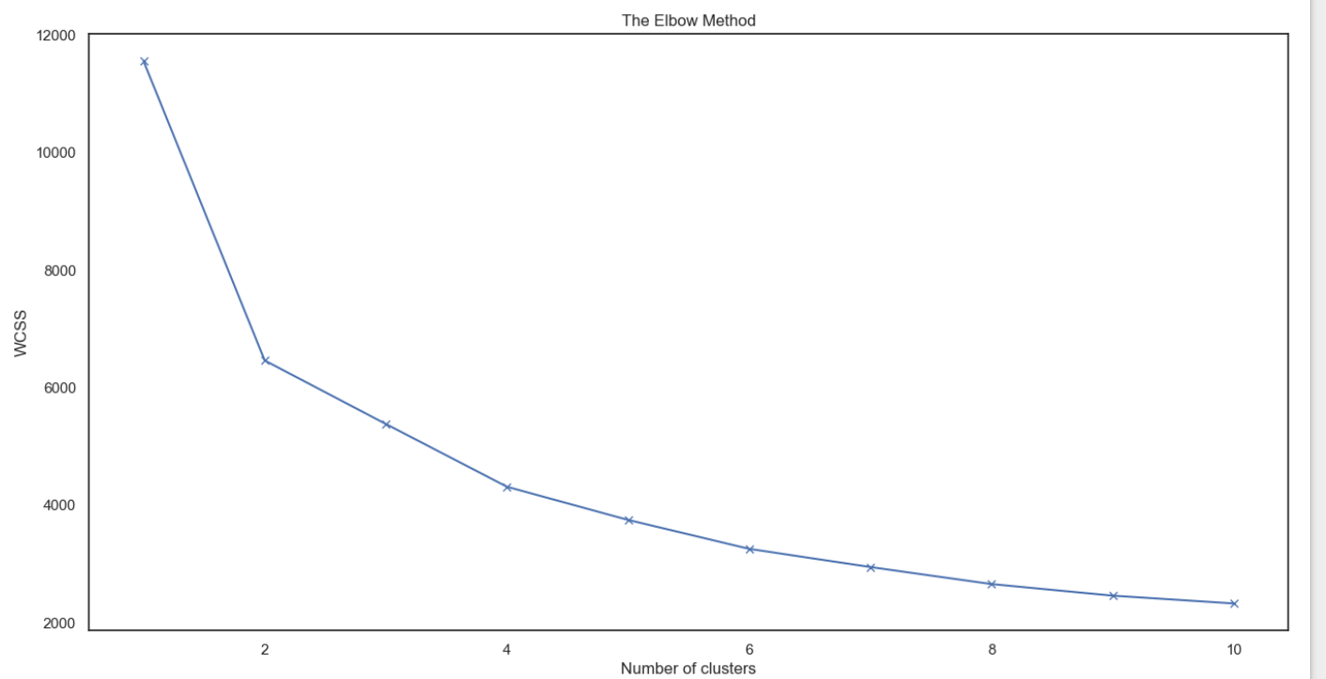
We can understand from the plot that cluster = 2 is the best... Elbow Method for K-Means Clustering

Slide 15
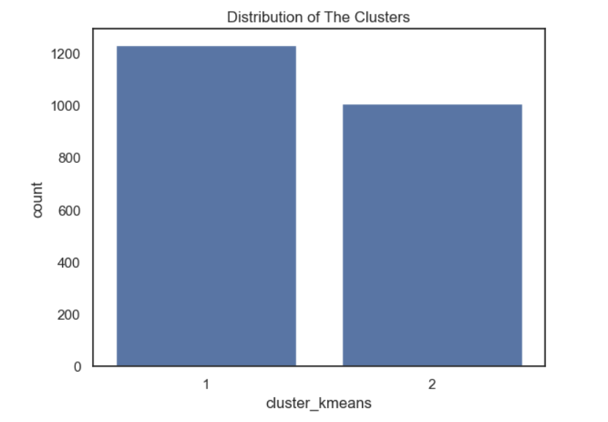
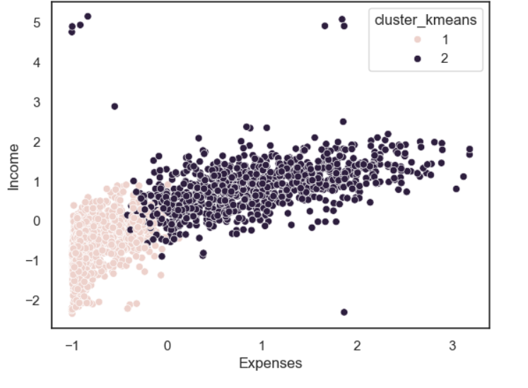
K-Means Clustering

Slide 16
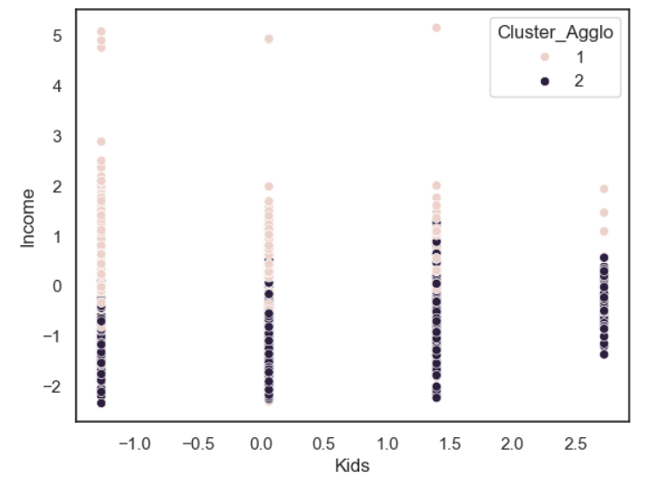
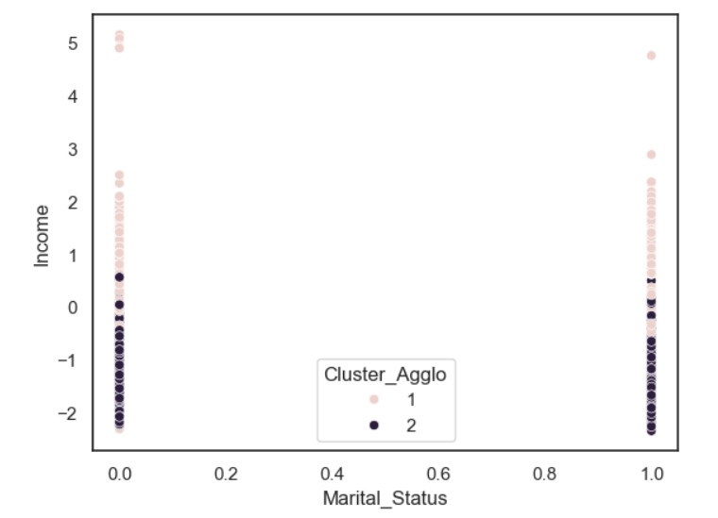
PCA with Aggolomerative Clustering

Slide 17
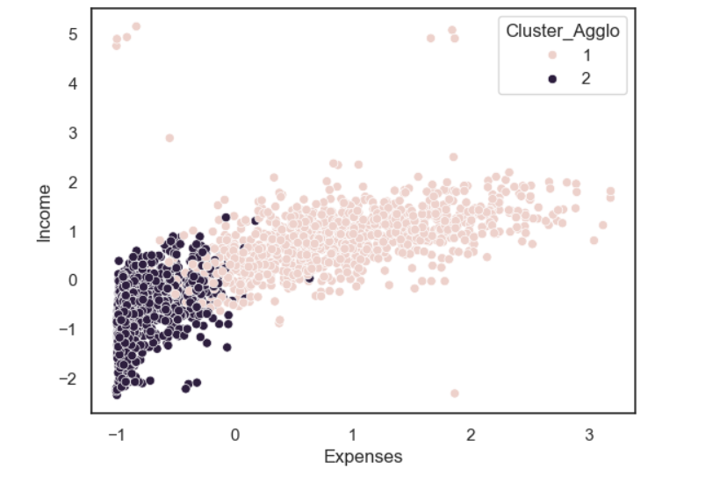
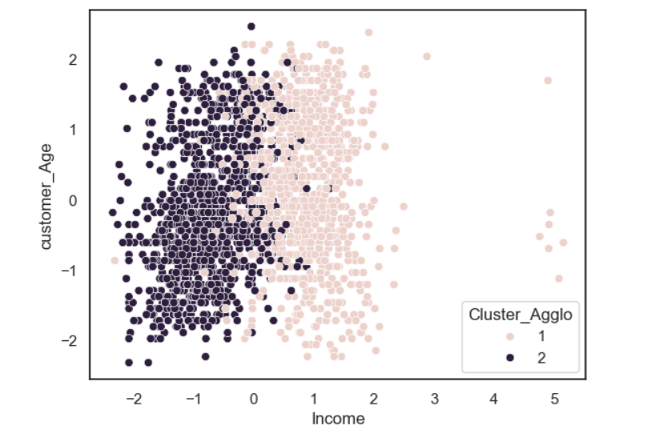

Slide 18
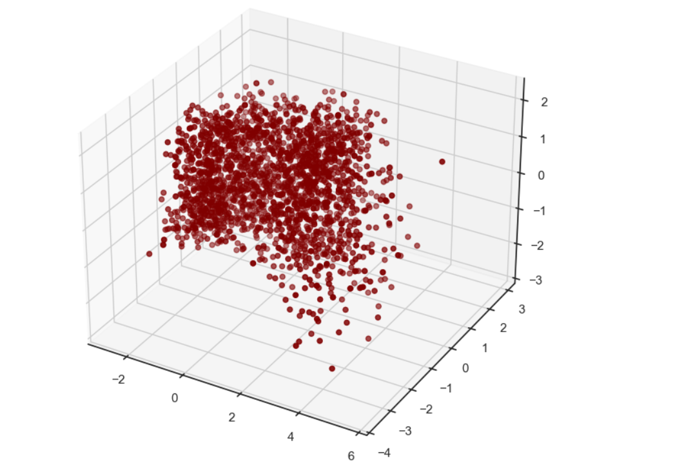
A 3D Projection of Data In The Reduced Dimension

Slide 19
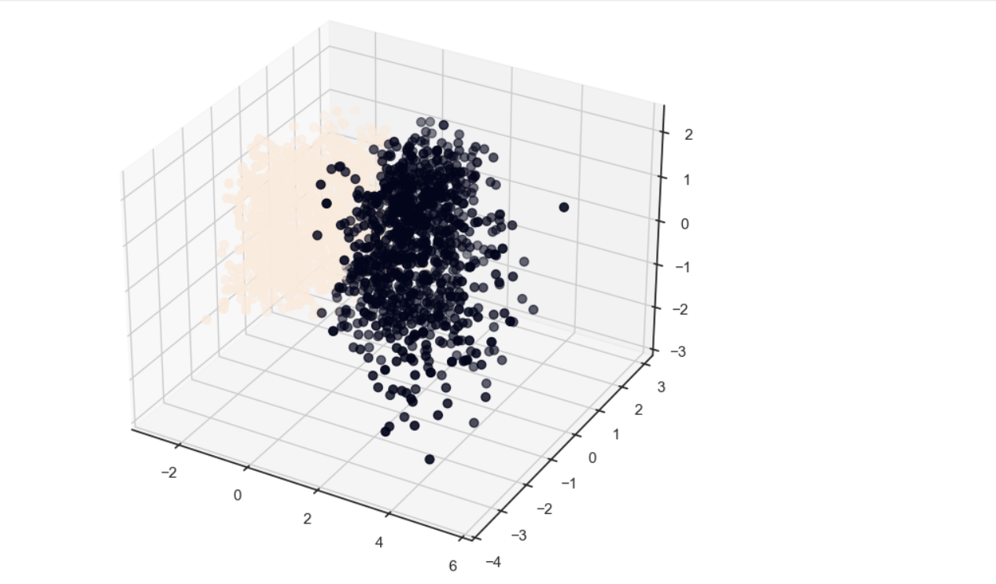
The Plot Of The Clusters

Slide 20
Conclusions:
Cluster 1:
People with less expenses :-
People who are married and parents of more than 3 kids
People with low income¶
Cluster 2:
People with more expenses :-
People who are single or parents of less than 3 kids
People with high income
Age is not the criteria but it is observed to some extent that people who are older fall in this group, so the customers falling in cluster2 likes to spend more...so the Firm's can target peoplefalling in cluster2 for the sale of their Products...¶

Slide 21
Model Deployment

Slide 22
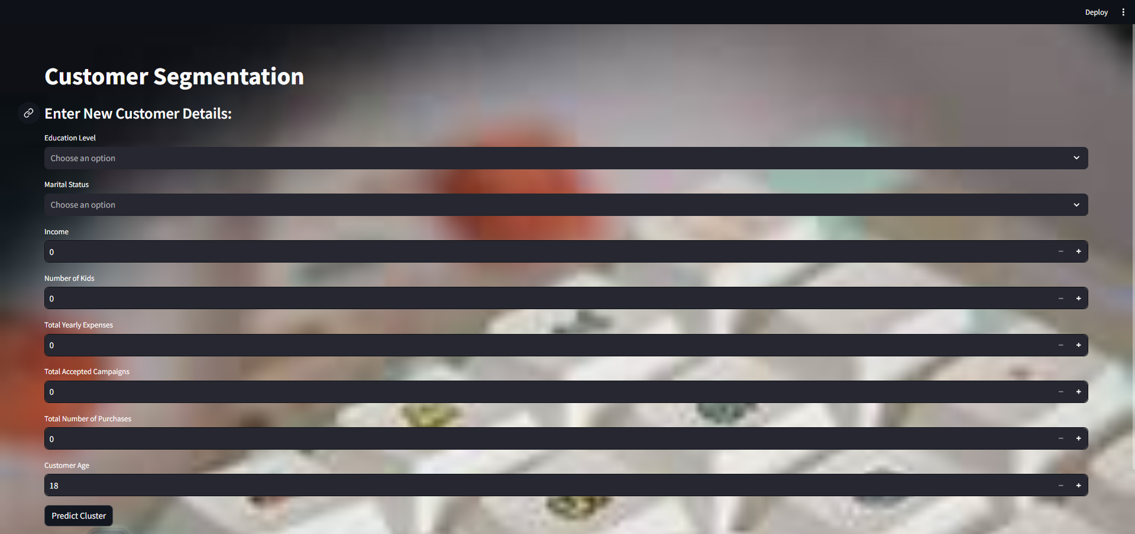

Slide 23
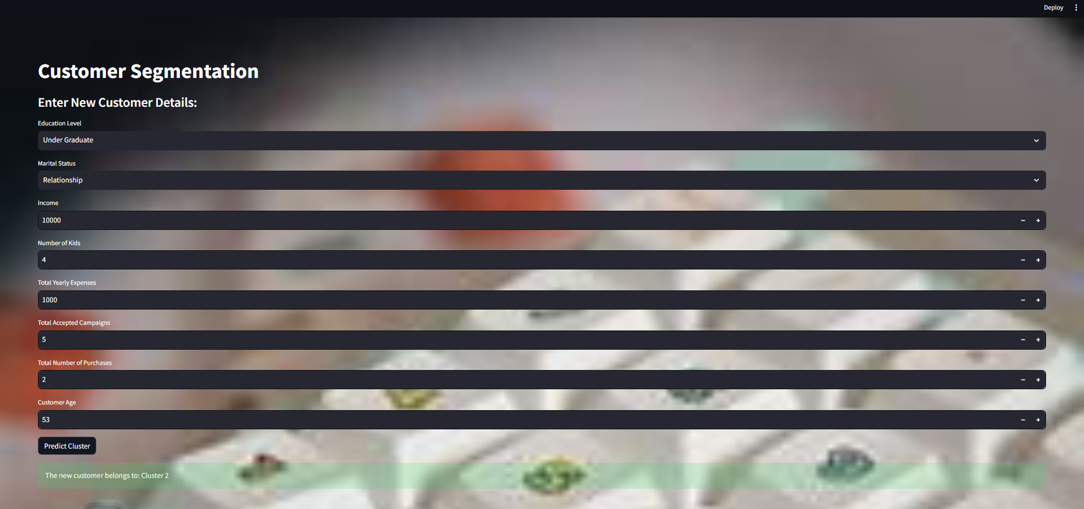

Slide 24
Problem faced while doing this project
Handling Missing Values:
The Income column has 24 missing values.
Solution: Use imputation techniques or remove rows if they significantly impact analysis.
Outlier Detection:
Identify and handle outliers using techniques like IQR or Z-score analysis.
Feature Engineering:
Create new features such as Age (2025 - Year_Birth) or Total_Spending.
Solution: These derived features can improve clustering and prediction models.
Clustering and Customer Segmentation:
Perform clustering algorithms (KMean) on spending-related features.
Goal: Identify customer segments for targeted marketing strategies.

Slide 25
Interactive Deployment with Streamlit
Deployment: Project deployed as an interactive web app using Streamlit.
Features:
1. Enable PCA for dimensionality reduction.
2. Choose clustering methods (KMeans, Agglomerative).
3. Visualize results dynamically.

Slide 26

THANK YOU !

